Slide 1
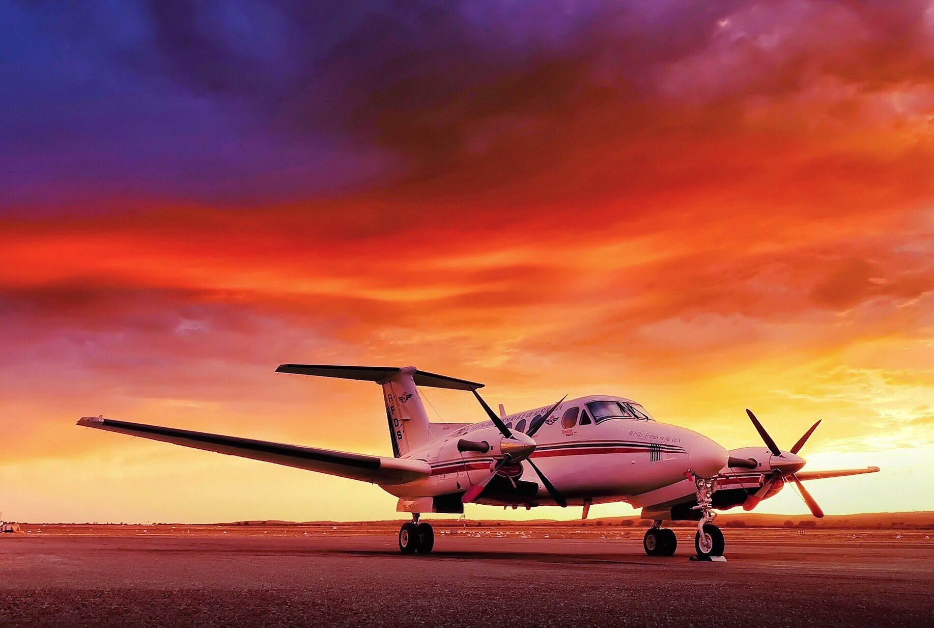
Aeromedical retrieval in remote Australia
Christophe Duchatelet, MD
Flight Physician RFDS
BESEDIM conference 2024

Slide 2
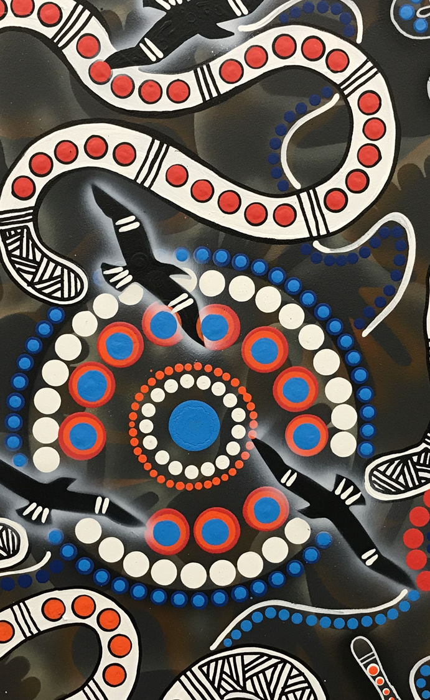
Introduction
RFDS in Broken Hill
Case
Challenges
Conclusion

Slide 3
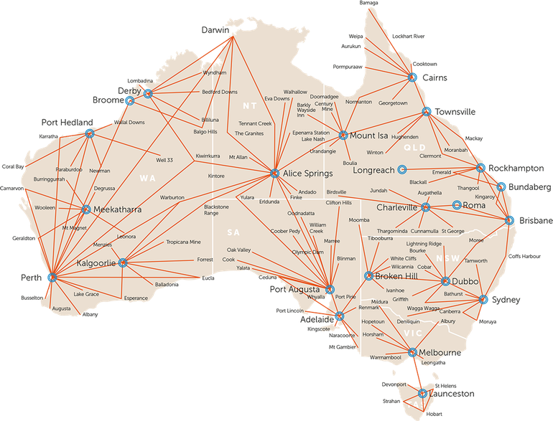
Royal Flying Doctor Service
23 Bases
81 Planes
36951 missions per year
Primary health care / Emergency Response
Primary Interventions/Interhospital transfers

Slide 4
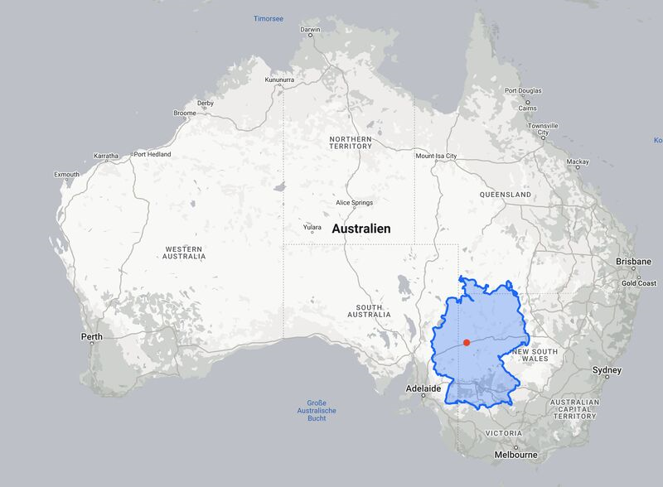
RFDS Broken Hill
Covering a land mass of approximately 640,000 km²
1x France
20x Belgium
1/12 Australia
Approximately 50 000 people

Slide 5
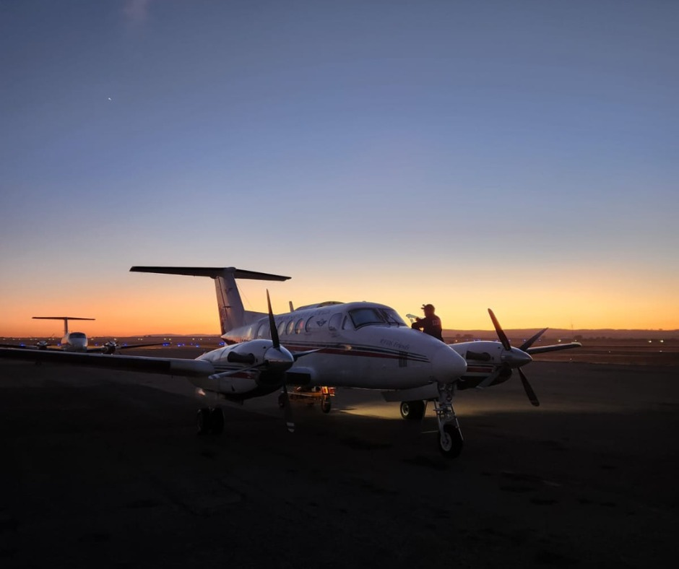
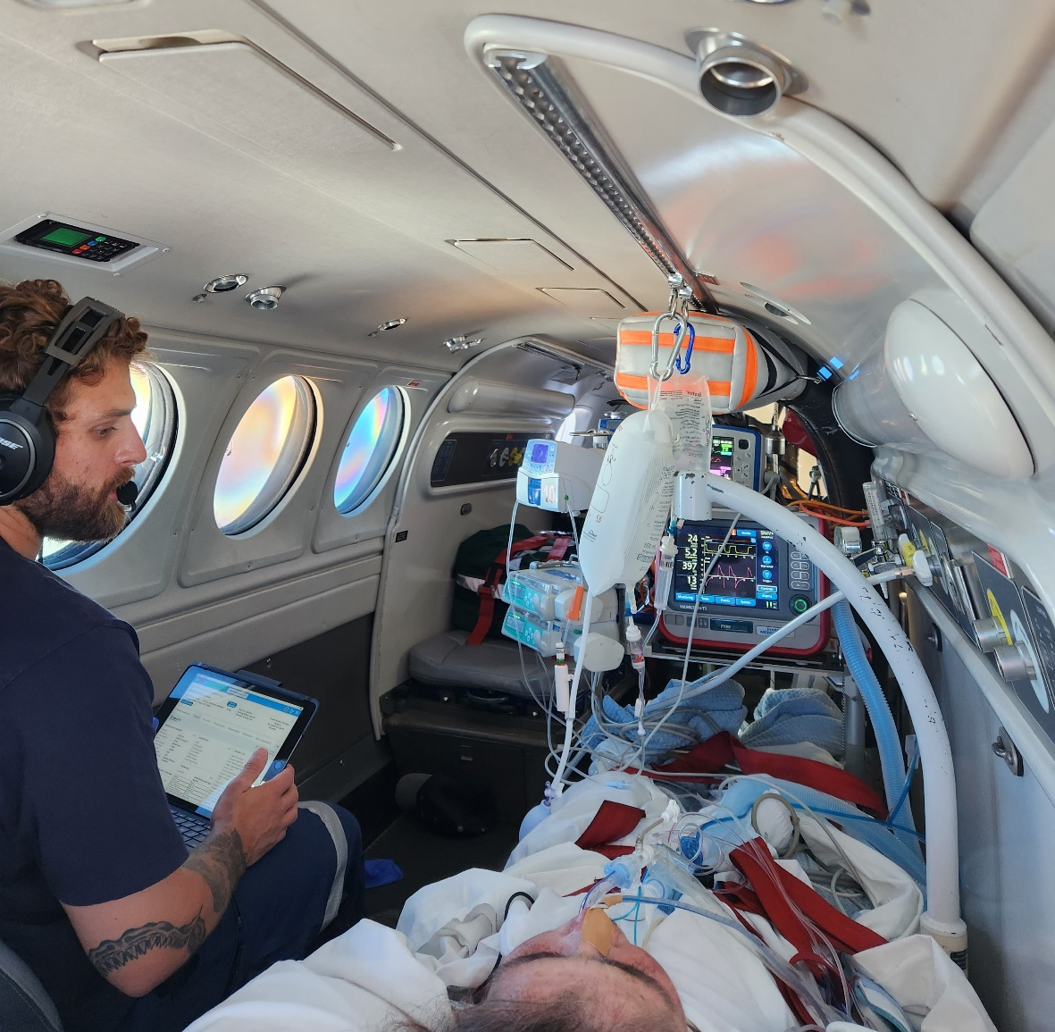
RFDS Broken Hill
2x Retrieval Beechcraft King Air 200 with full ICU set up

Slide 6
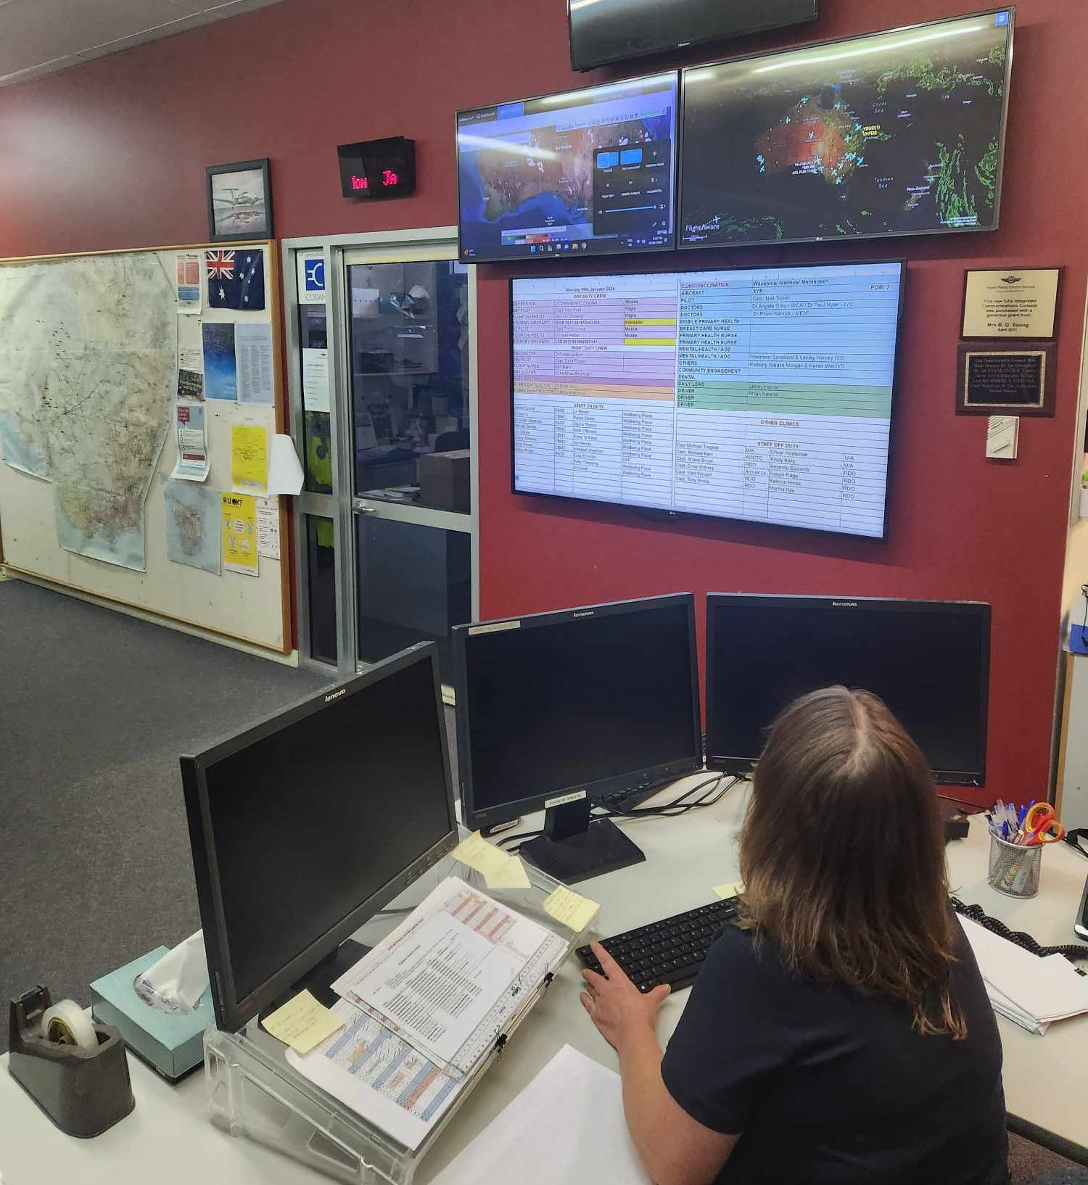
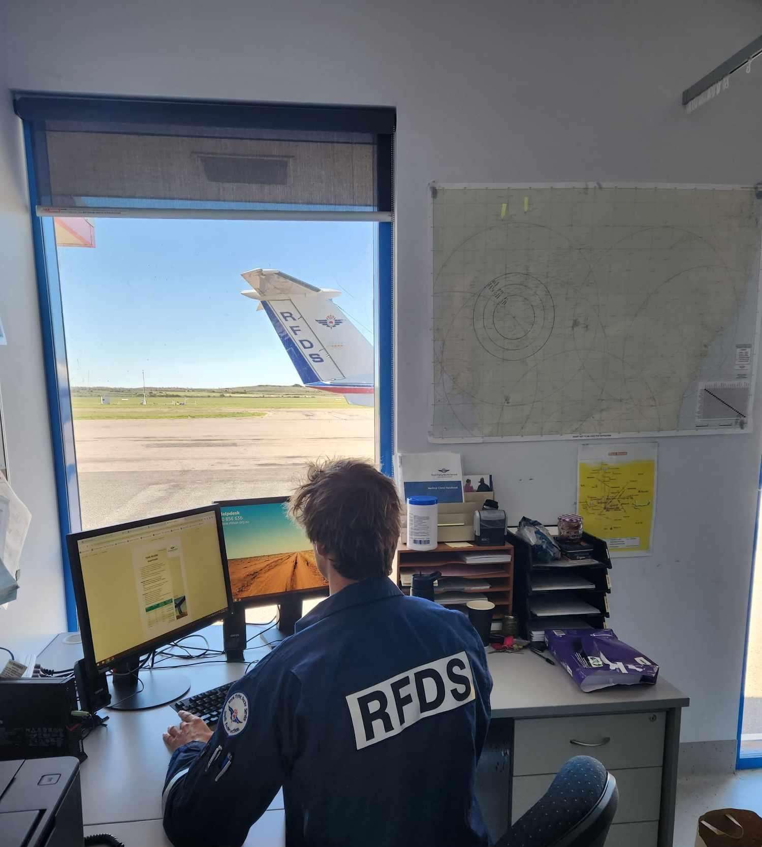
Case description
RFDS Emergency Line
Subject: Farmer crashes plane, pilot trapped, conscious, back pain
Call

Slide 7
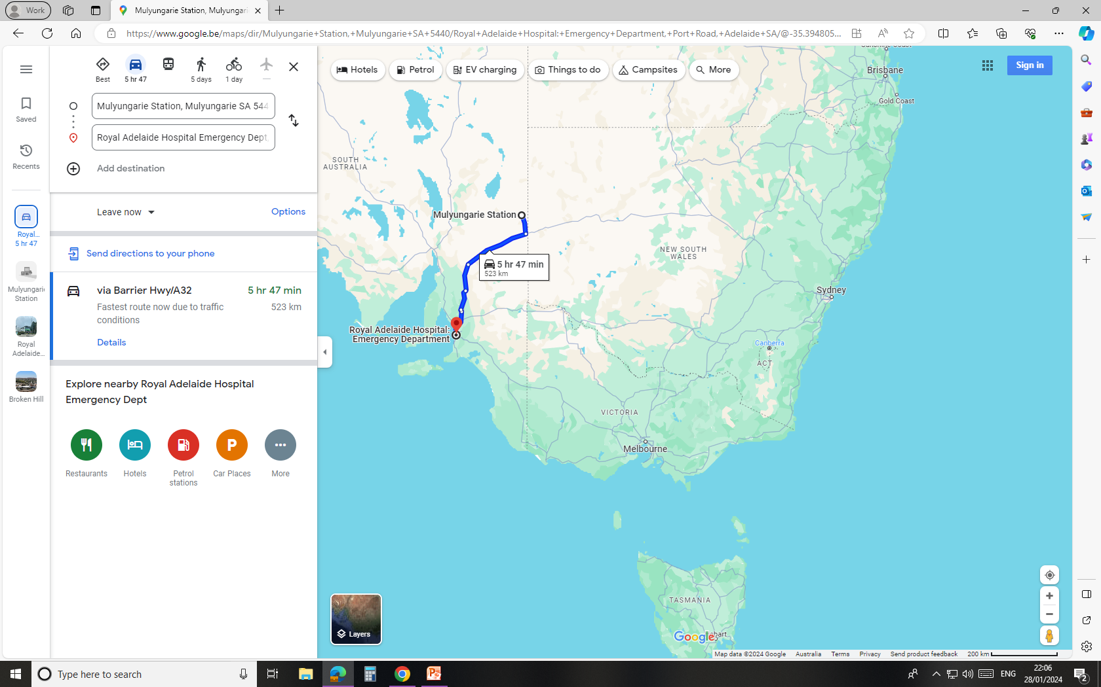
Case Description

Slide 8
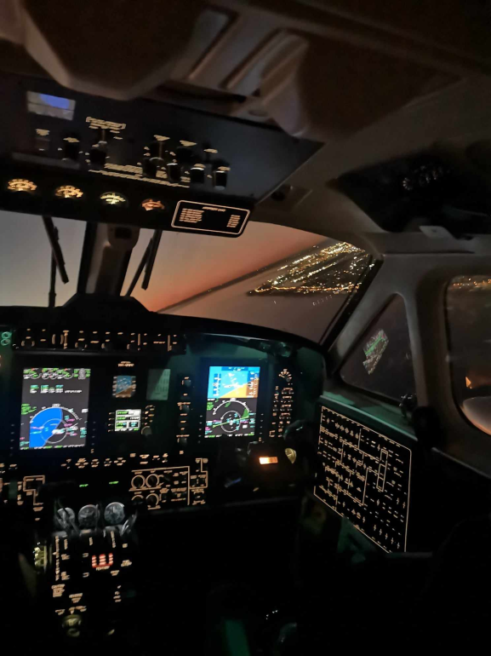
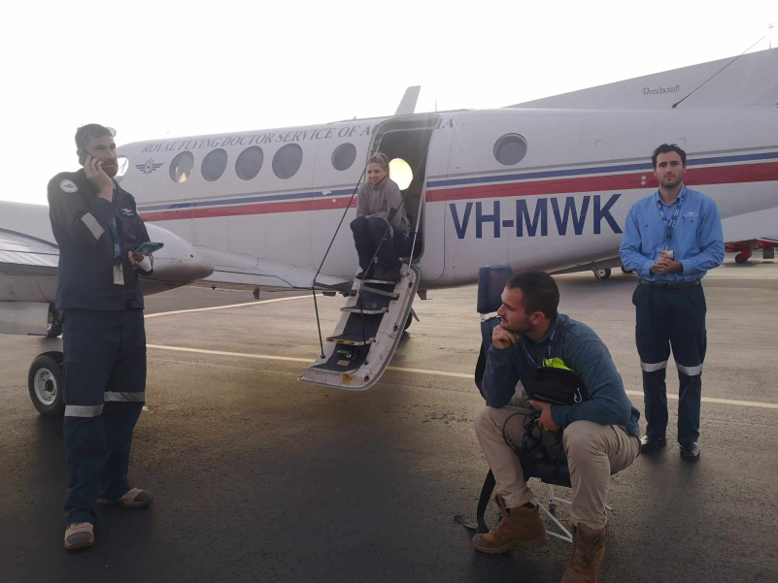
Case Description
Aviation planning by RFDS pilots
Plan A: Sand strip landing Mulyungarie guided by kerosene fires
Plan B: Honeymoon Mine Site + 32 km by 4wd
Take off: 6 pm

Slide 9
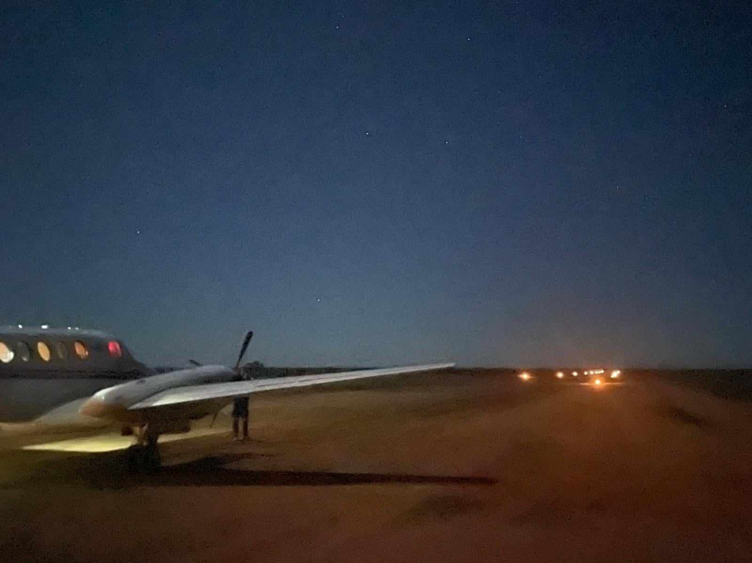
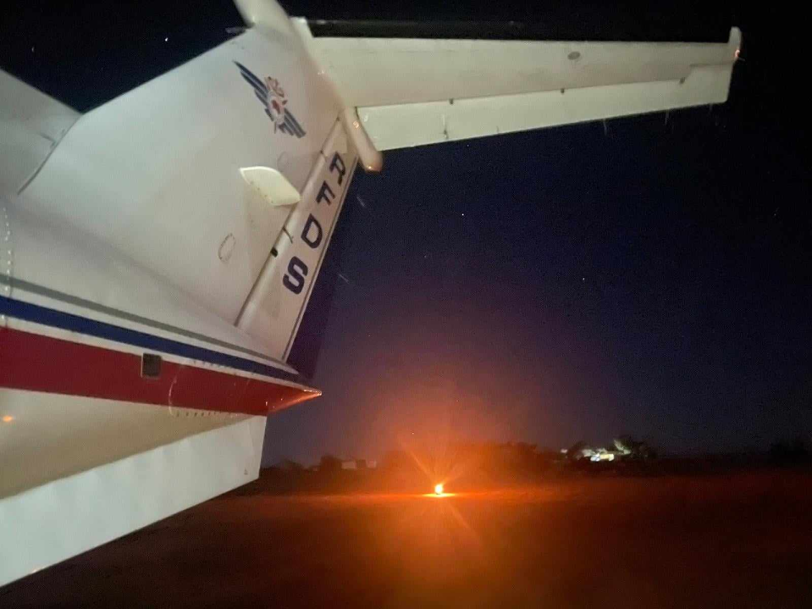
Case Description
Touch down Mulyungarie: 7.15 pm

Slide 10
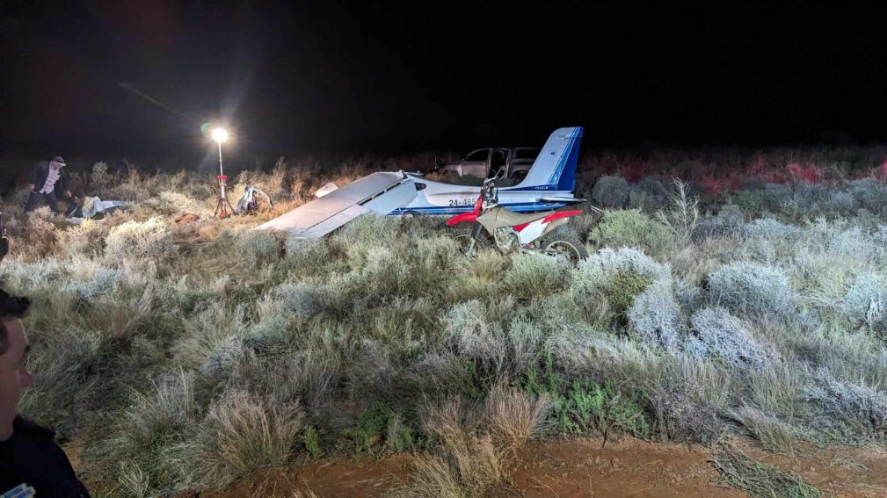
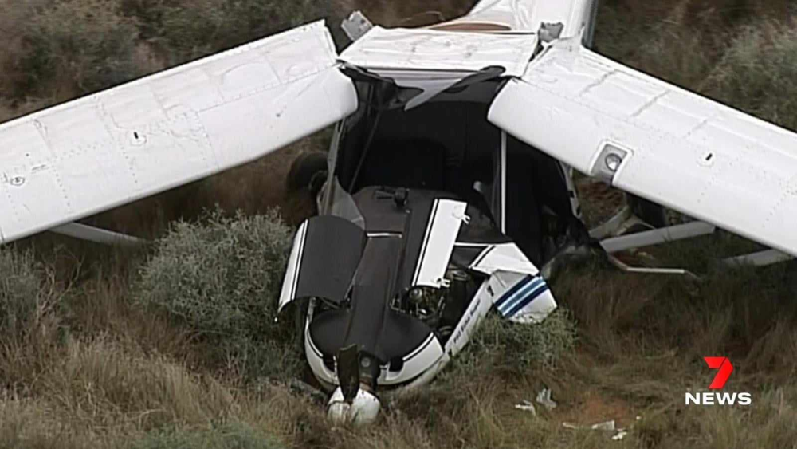
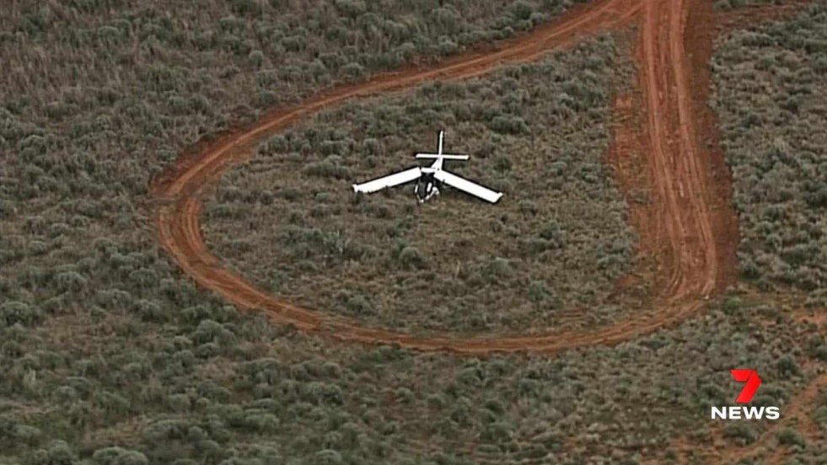
Case Description
Site of incident

Slide 11
Case Description
Clinical:
ABC stable
D: GCS 15/15, PEARL, no lateralisation, numbness and paraesthesia LL
E: bruising LLQ, collarbone left side painful. Swollen left ankle. Skin intact. Temp 34.5.
AMPLE: Depression and anxiety, Escitalopram. No allergies.
Interventions:
eFAST: Lung sliding left side??
2x lV 14G
4x 50 mcg Fentanyl IV
2x 25mg Ketamine IV
Full immobilisation
Temperature control
Retrieval to Royal Adelaide Hospital – Trauma Centre

Slide 12
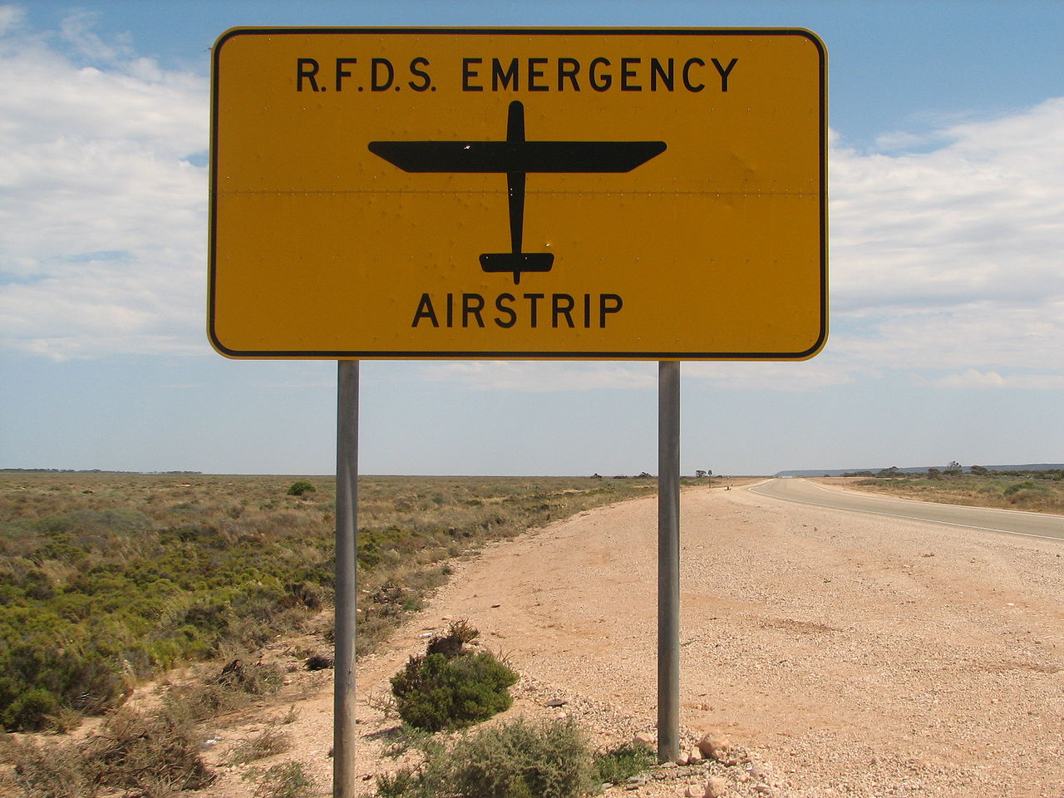
Challenges
Terrain access:
RFDS AIRCRAFT LANDING AREAS (ALA) Guide
+/- 350 approved landing strips
Airports
Highway
Sand strips on private property. Yearly check
In cooperation with farm owners

Slide 13
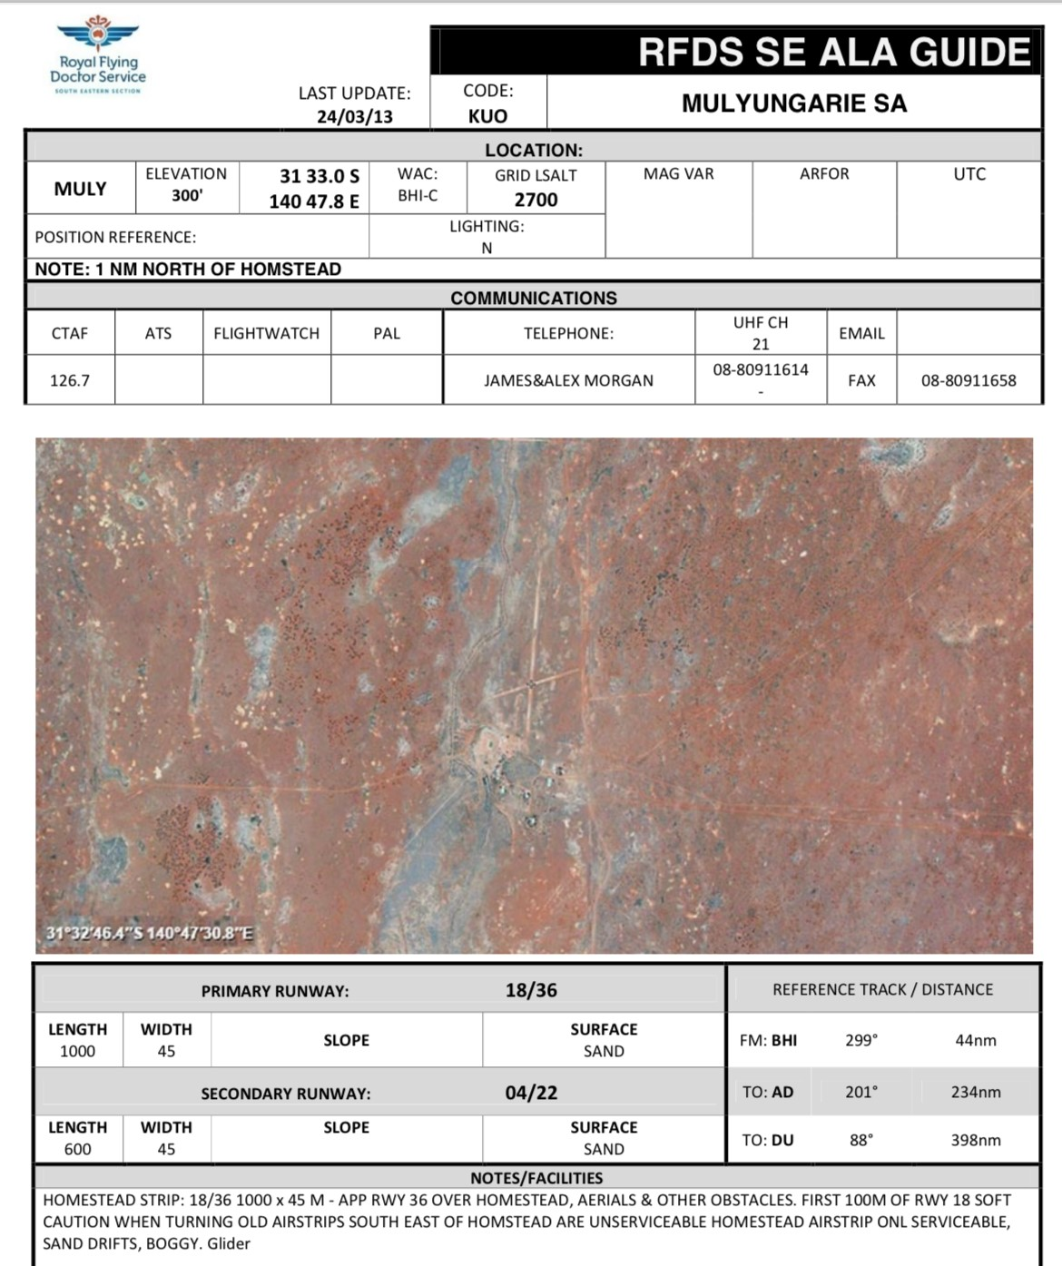
Challenges
Terrain access:
Civil Aviation Safety Authority guidelines
15m width
>900m long
Clear of obstacles
Sufficient lighting
Beechcraft King Air 200
Performance ++
Short strips
High temperatures

Slide 14
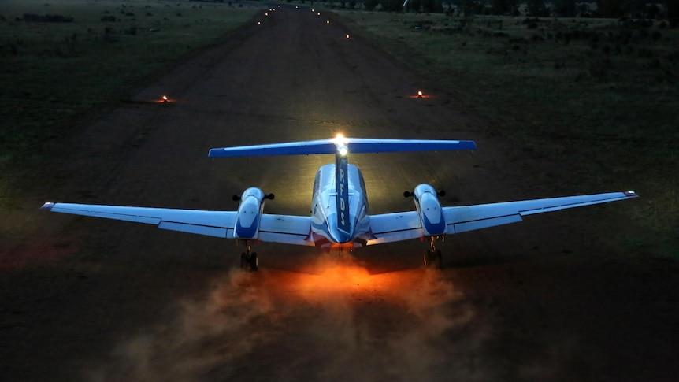
Challenges
Sufficient lighting
Airport Strip: Permanent Artificial
Sand Strip:
Battery-powered LED lights
Solar Airfield Lighting
Toilet rolls soaked in diesel
Kerosene Lanterns
4WD`s lined up to indicate start of strip
Wind direction: radio contact with 4WD`s providing live updates (channel 13)
https://www.abc.net.au/news/2023-01-16/rfds-outback-airstrip-landing-lights-lanterns/101841034

Slide 15
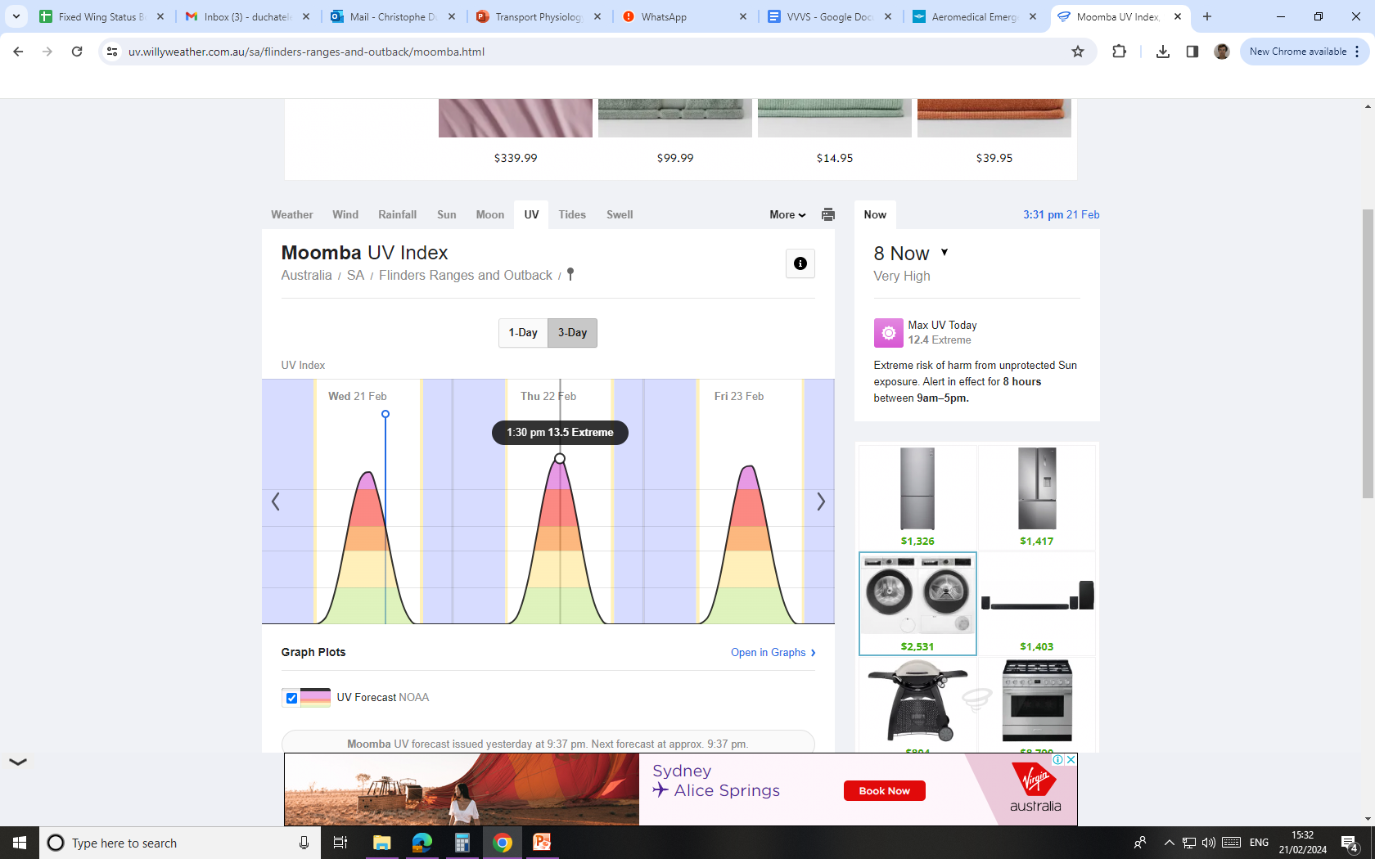
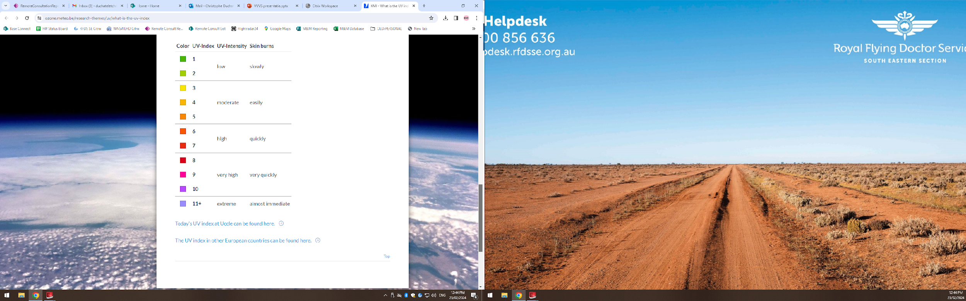
Challenges
Temperature & UV index
Hot! 43-55 Celsius

Slide 16
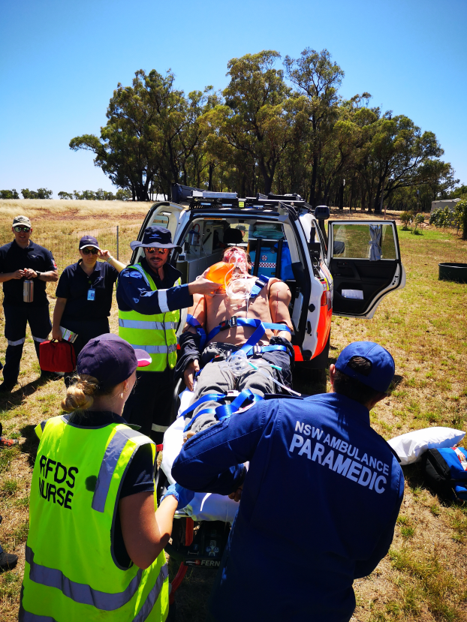
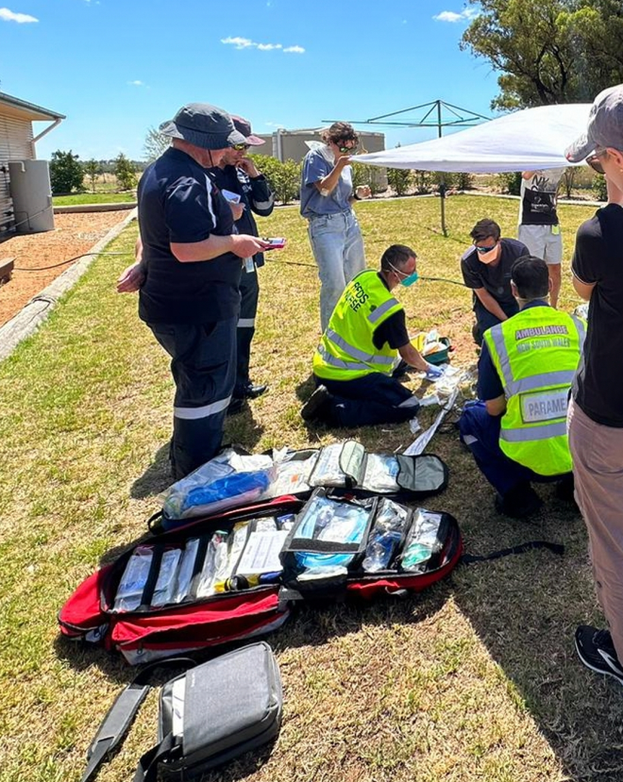
Challenges
Sun Protection!

Slide 17
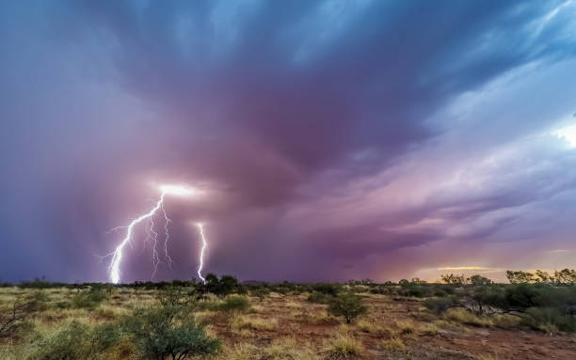
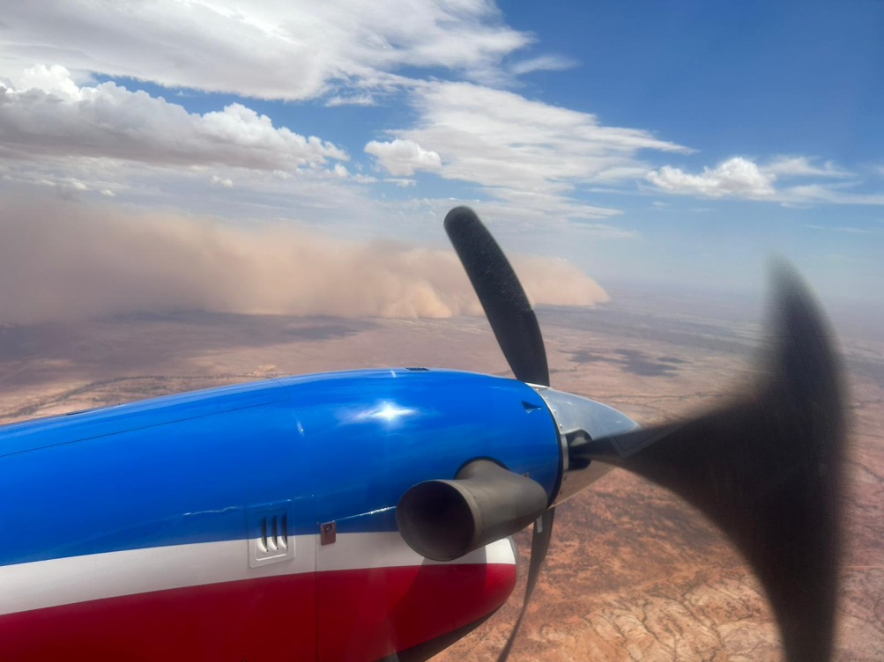
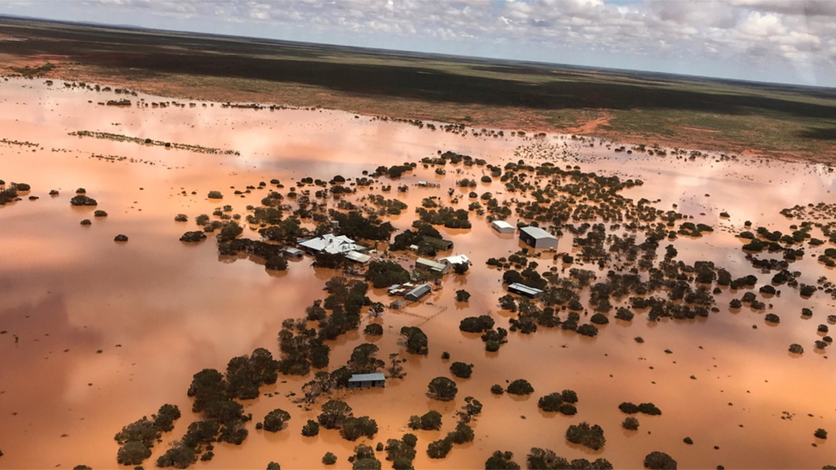
Challenges
Weather
Thunderstorms
Sandstorms
Flooding

Slide 18
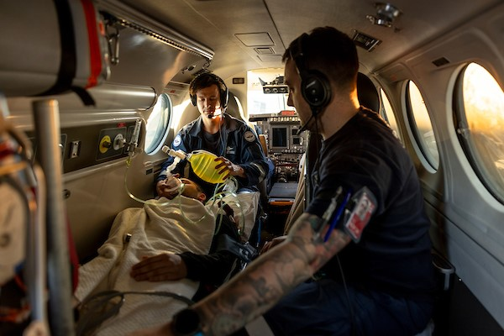
Challenges
Small confined space
Commitment as soon as doors closed
Defibrillation: confirm with pilot, not during take-off or landing
Medevac request
Airspace priority
1 Pilot
Crew Resource Management
Toilet?
8-10 hours intervention times

Slide 19
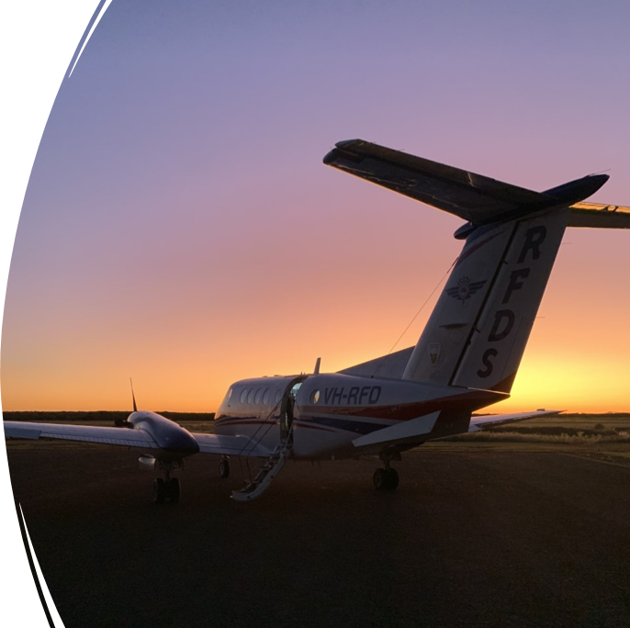
Challenges
Impact of transport by air on human physiology
Multiple stresses on the human body
Amplified in patients who are critically unwell
Acceleration/deceleration
Altitude
Vibration

Slide 20
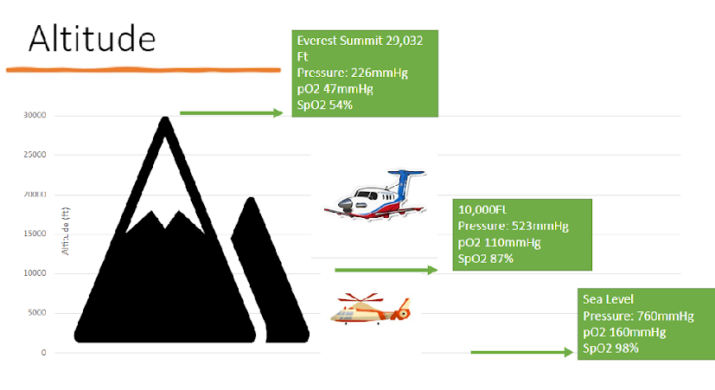
Challenges

Slide 21
Challenges
Solutions to reduced PAO2 at altitude:
Supplementary oxygen (^FiO2)
Increase pressurisation of cabin: fly at lower altitude
Ensure adequate resuscitation prior to transfer
Consider positive pressure ventilation
PAO2 = FiO2 (Patm – PH20) – PaCO2/RQ

Slide 22
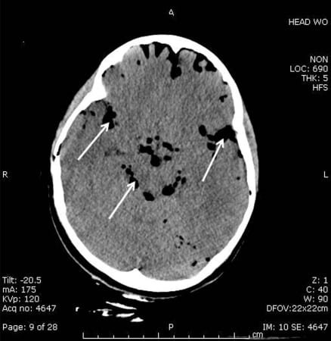
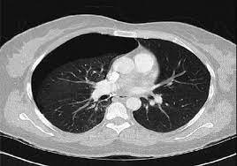
Challenges
Clinical issues necessitating transfer at low altitude:
Diving decompression illness
Lung/chest injuries
Penetrating eye injury
Facial fractures of base of skull fractures
Large unreduced hernias/Volvulus/Intussusception
Dental abscess/middle Ear infection/mastoiditis

Slide 23
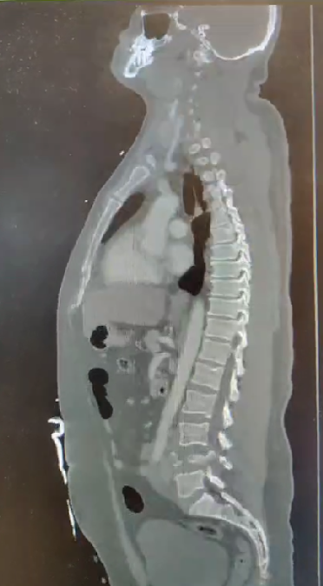
Case Description
Follow up:
Comminute burst fracture L4
Fragments in spinal canal and retropulsion
Epidural hematoma L3 – S2
Severe canal stenosis + cauda equina syndrome
R/
L2-S1 posterior fixation decompression + repair dural defect
L4 corpectomy + cage reconstruction
Small pneumothorax left lung + 6 rib fractures + lung contusion
R/Conservative
- Left weber C ankle fracture R/ORIF
Retroperitoneal hematoma R/Conservative

Slide 24
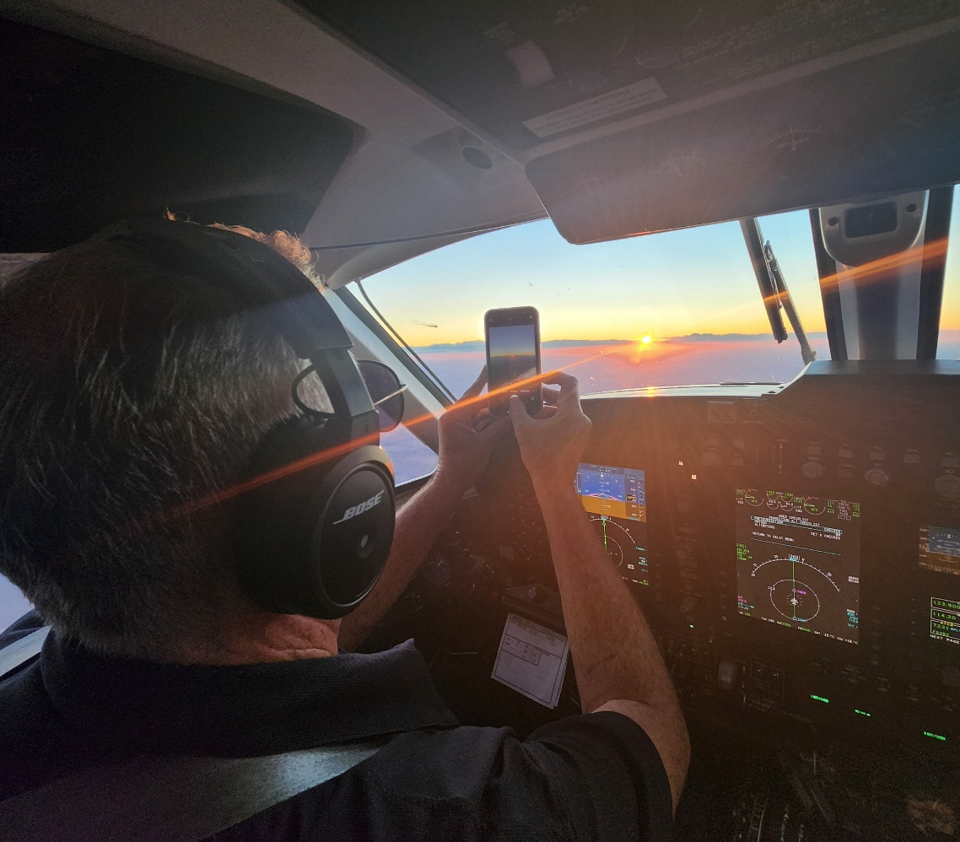
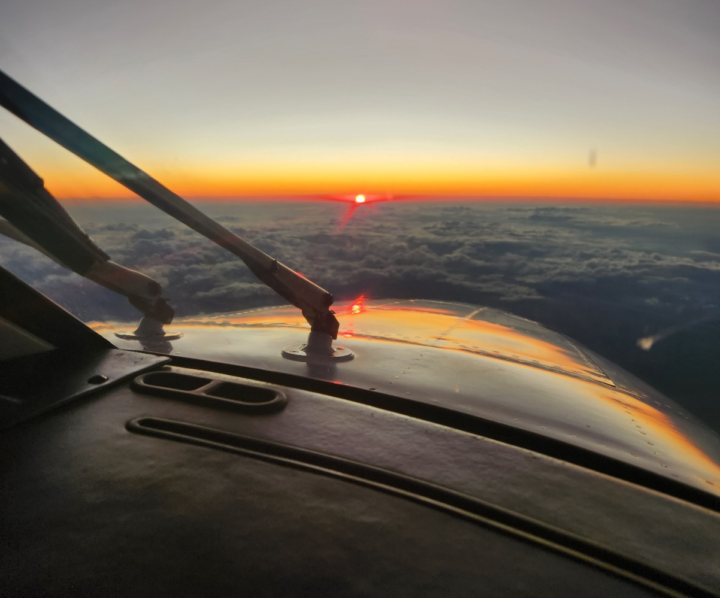
Conclusion

Slide 25
Thank you!

